Slide 1
Little Wandle
Handwriting Formation
Lower Case and Capital Letters
© Little Wandle Letters and Sounds

Slide 2
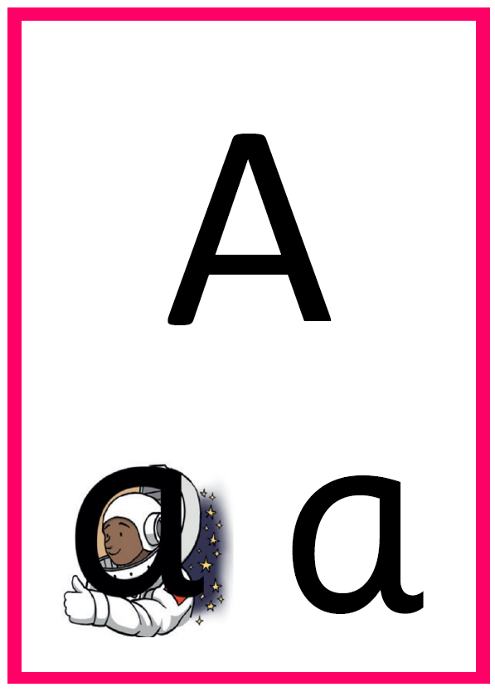
Lowercase Letter Rhyme
Around the astronaut’s helmet and down into space...
Capital Letter Rhyme
From the top, diagonally down to the left, up to the top, diagonally down to the right. Lift up and across.

Slide 3
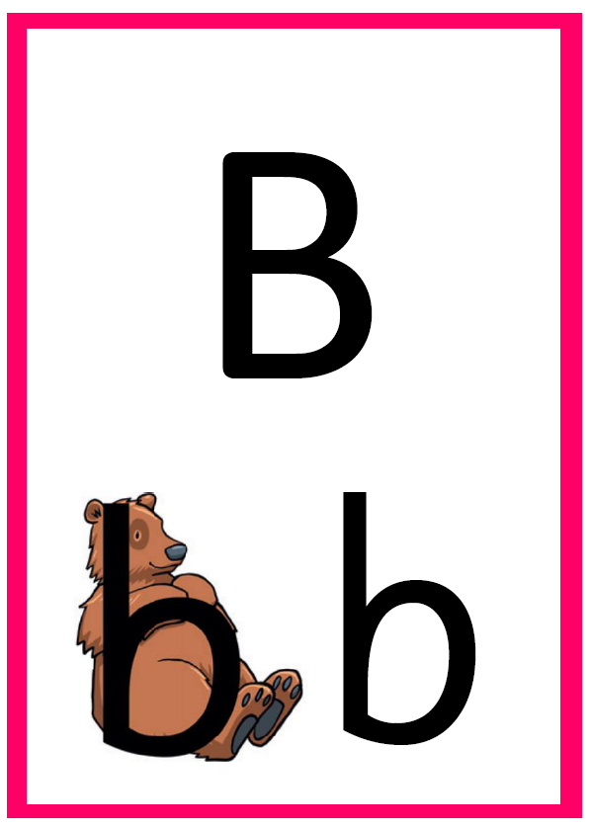
Lowercase Letter Rhyme
Down bear’s back, up and round his big tummy.
Capital Letter Rhyme
From the top, down, back to the top. Round to the middle, round to the bottom.

Slide 4
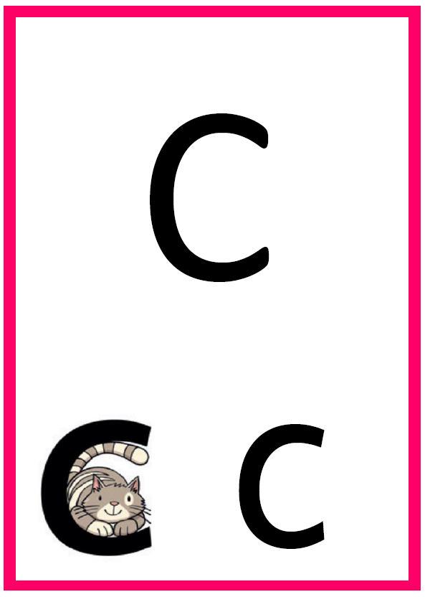
Lowercase Letter Rhyme
Curl around the cat.
Capital Letter Rhyme
From the top, curl around to the left to sit on the line.

Slide 5
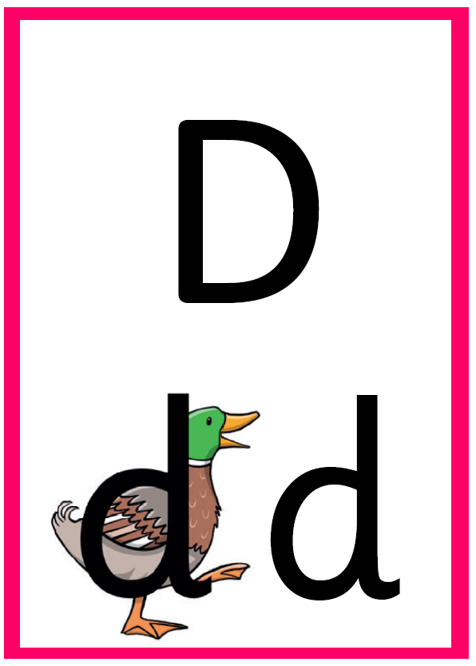
Lowercase Letter Rhyme
Round the duck’s body, up to its head and down to its feet.
Capital Letter Rhyme
From the top, down, back to the top. Curve right, down to the bottom.

Slide 6
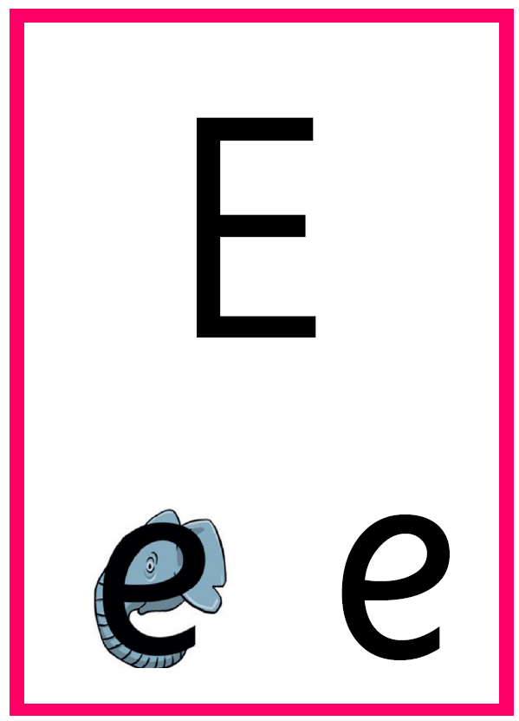
Lowercase Letter Rhyme
Around the elephant’s eye and down its trun.
Capital Letter Rhyme
From the top, down, back to the top. Across, back. Lift up and across the middle. Lift up and across the bottom line.

Slide 7
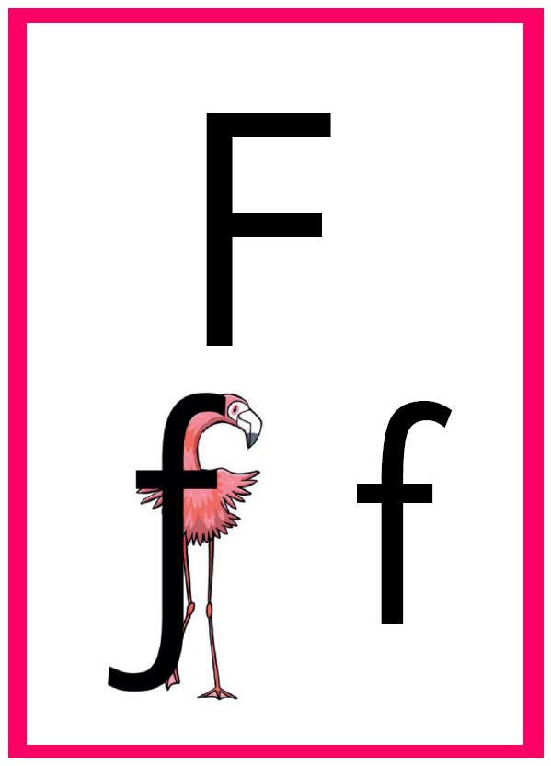
Lowercase Letter Rhyme
Down the flamingo’s neck, all the way to its foot, then across its wings.
Capital Letter Rhyme
From the top, down, back to the top. Across, back. Lift up and across the middle.

Slide 8
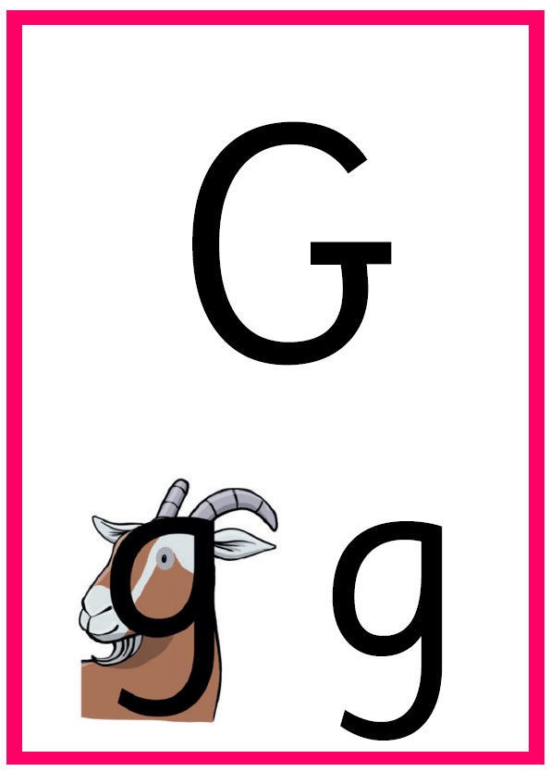
Lowercase Letter Rhyme
Round the goat’s face, up to his ear; down and curl under his chin.
Capital Letter Rhyme
From the top, curl around to the line, carry on up, then straight down. Lift up and across.

Slide 9
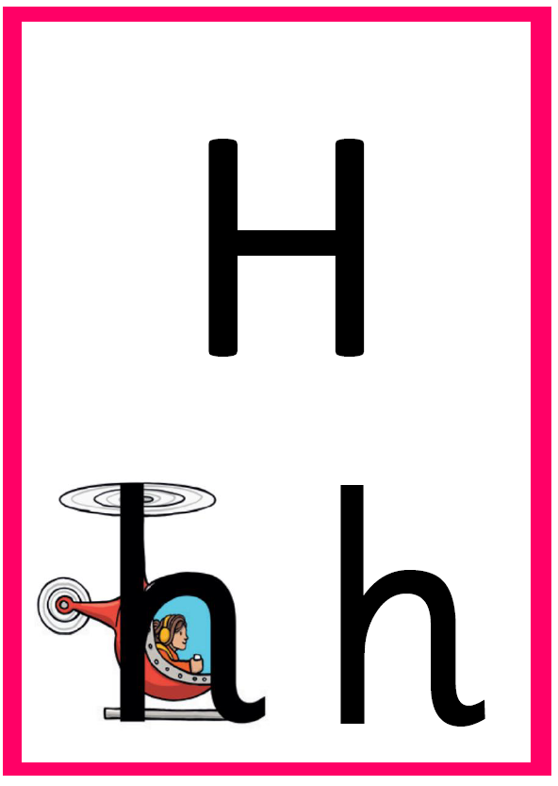
Lowercase Letter Rhyme
Down, up and over the helicopter.
Capital Letter Rhyme
From the top and down. Space. From the top and down. Lift up and join the lines across the middle.

Slide 10
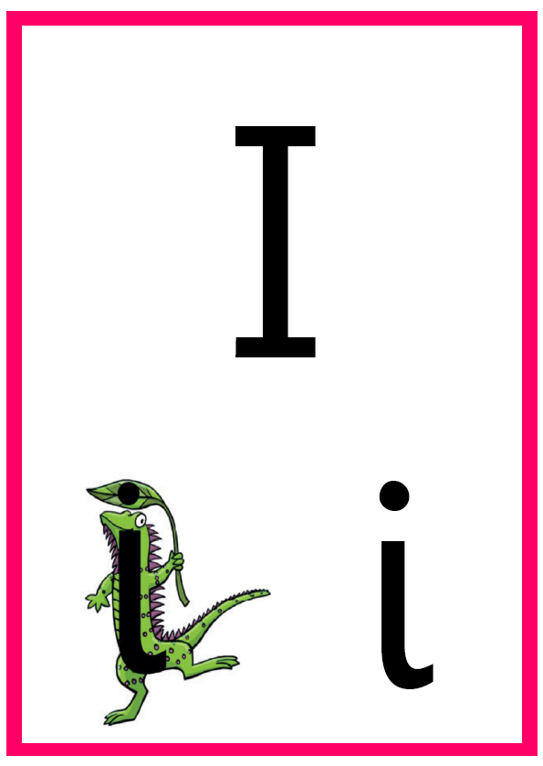
Lowercase Letter Rhyme
Down the iguana’s body, then draw a dot [on the leaf] at the top.
Capital Letter Rhyme
From the top to the bottom and stop.

Slide 11

Lowercase Letter Rhyme
All the way down the
jellyfish. Dot on its head.
Capital Letter Rhyme
From the top, all the way down, then short curl to the left.

Slide 12

Lowercase Letter Rhyme
Down the kite, up and across, back and down to the corner.
Capital Letter Rhyme
From the top, down, up to the middle. Diagonally up, back and diagonally down to the line.

Slide 13
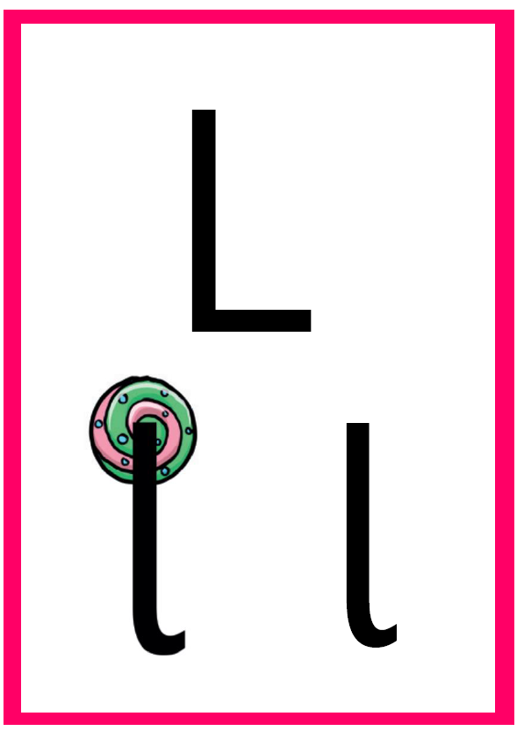
Lowercase Letter Rhyme
All the way down the lollipop.
Capital Letter Rhyme
From the top, down and across the line.

Slide 14
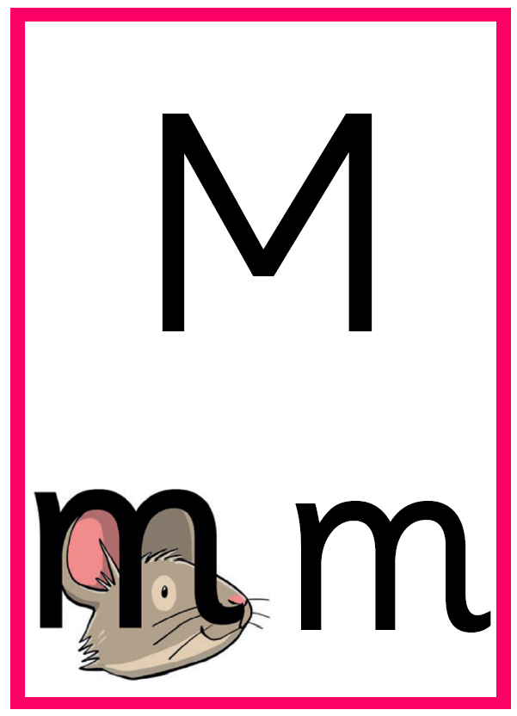
Lowercase Letter Rhyme
Down, up and over the mouse’s ears, then add a flick on the nose.
Capital Letter Rhyme
From the top, down, back to the top. Diagonally down, diagonally up. Straight down to the line.

Slide 15
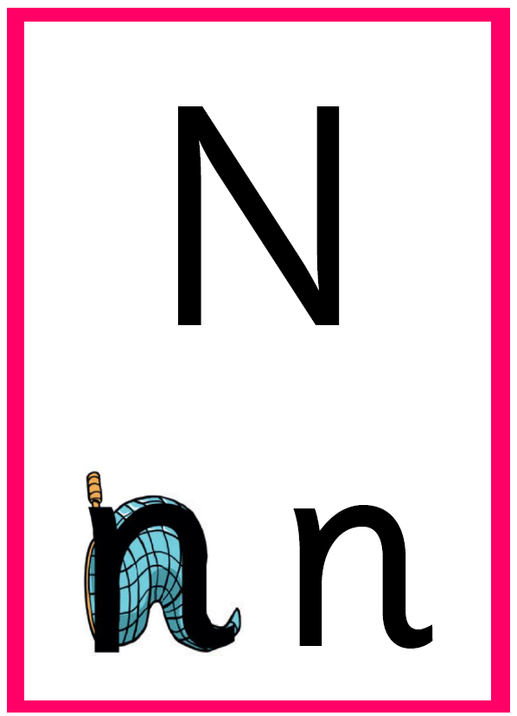
Lowercase Letter Rhyme
Down the stick, up and over the net.
Capital Letter Rhyme
From the top, down, back to the top. Diagonally down, then straight up to the top.

Slide 16
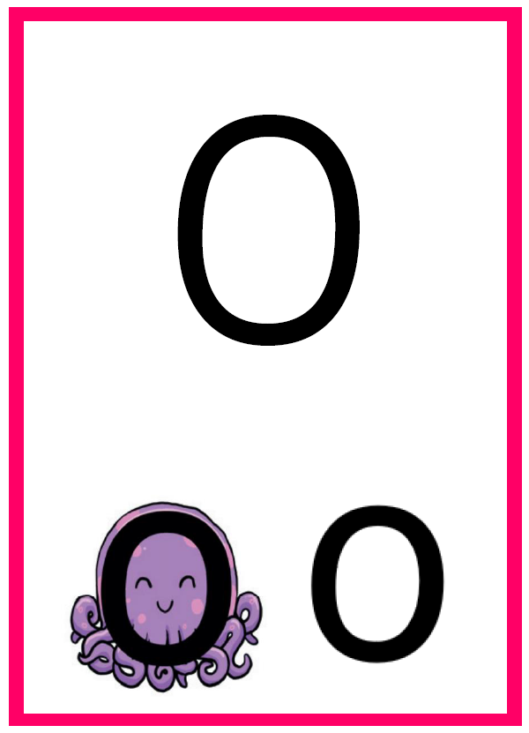
Lowercase Letter Rhyme
All around the octopus..
Capital Letter Rhyme
From the top – all around the o.

Slide 17
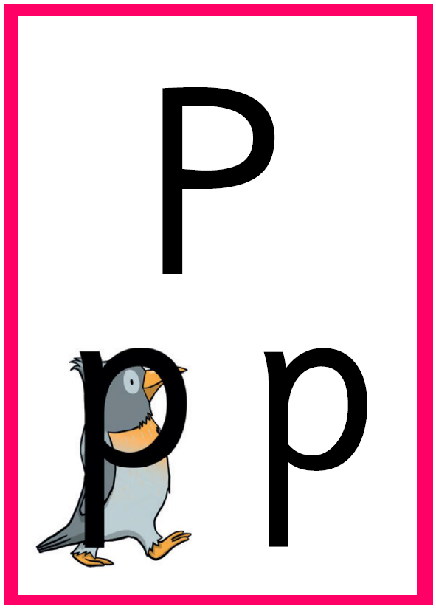
Lowercase Letter Rhyme
Down the penguin’s back, up and around its head.
Capital Letter Rhyme
From the top, down then back up. Curve right to halfway down.

Slide 18
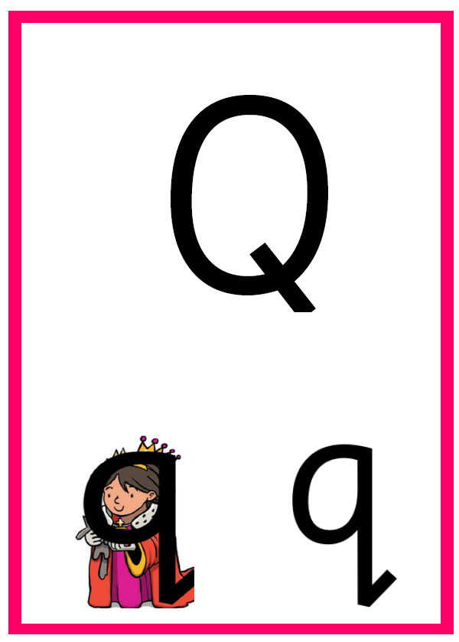
Lowercase Letter Rhyme
Round the queen’s face, up to her crown, down her robe with a flick at the end.
Capital Letter Rhyme
From the top – all around the o. Lift off. Short line diagonally down.

Slide 19
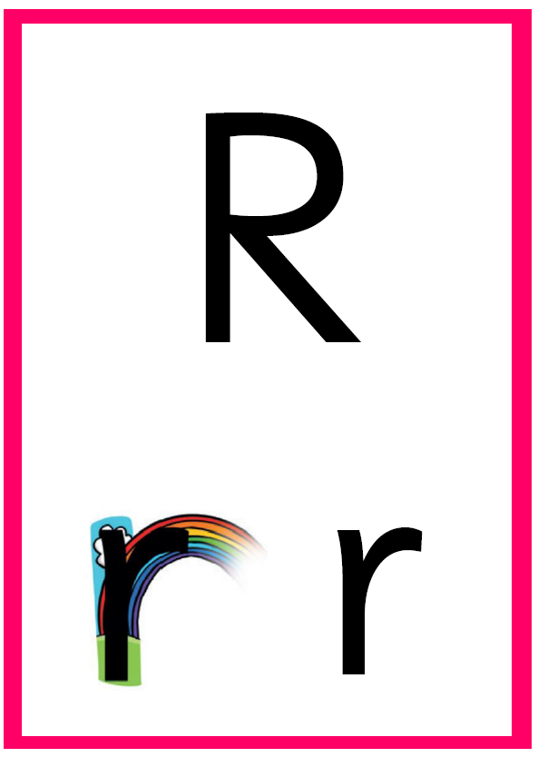
Lowercase Letter Rhyme
From the cloud to the ground, up the arch and over the rainbow.
Capital Letter Rhyme
From the top, down, then back up. Curve right to halfway down. Diagonally down to the line.

Slide 20
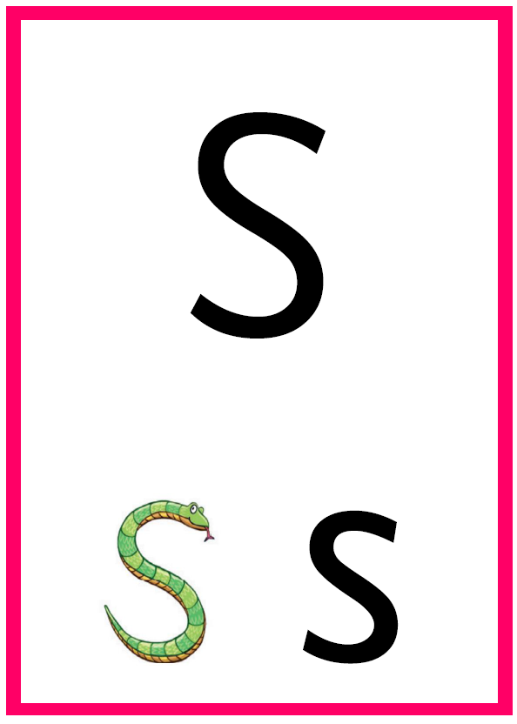
Lowercase Letter Rhyme
Under the snae’s chin, slide down
and round its tail.
Capital Letter Rhyme
From the top, under the snake’s chin, slide down and round its tail.

Slide 21
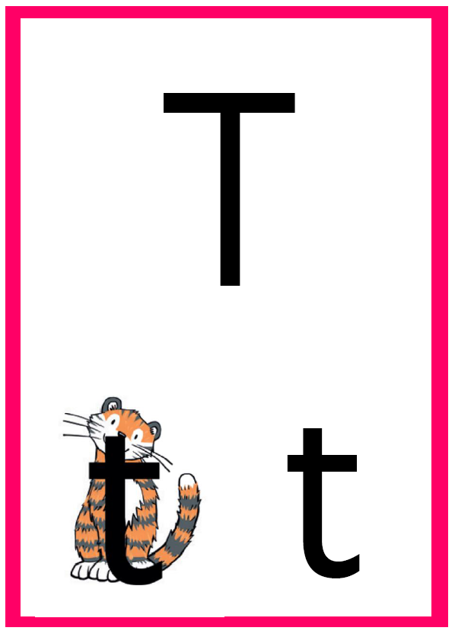
Lowercase Letter Rhyme
From the tiger’s nose to its tail, then follow the stripe across the tiger.
Capital Letter Rhyme
From the top, down and stop. Lift up and from the left, make a line across the top.

Slide 22
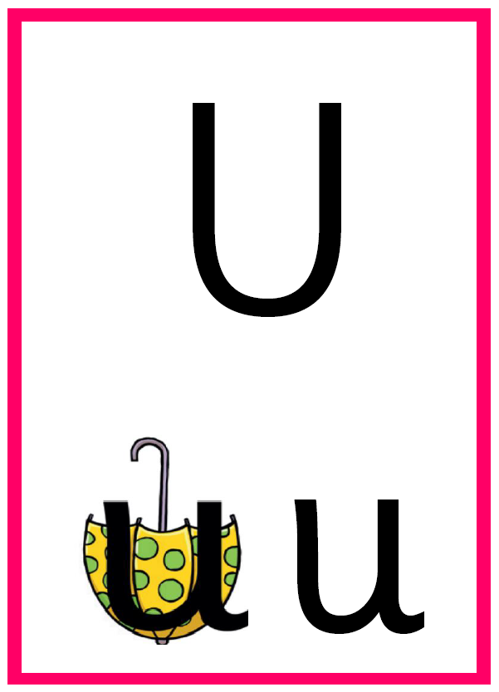
Lowercase Letter Rhyme
Down and around the umbrella,
stop at the top and down to the
bottom and flic
Capital Letter Rhyme
From the top, down and curve right, then straight up to the top.

Slide 23

Lowercase Letter Rhyme
Down to the bottom of the volcano and back up to the top.
Capital Letter Rhyme
From the top diagonally right to the bottom, then diagonally up to the top.

Slide 24
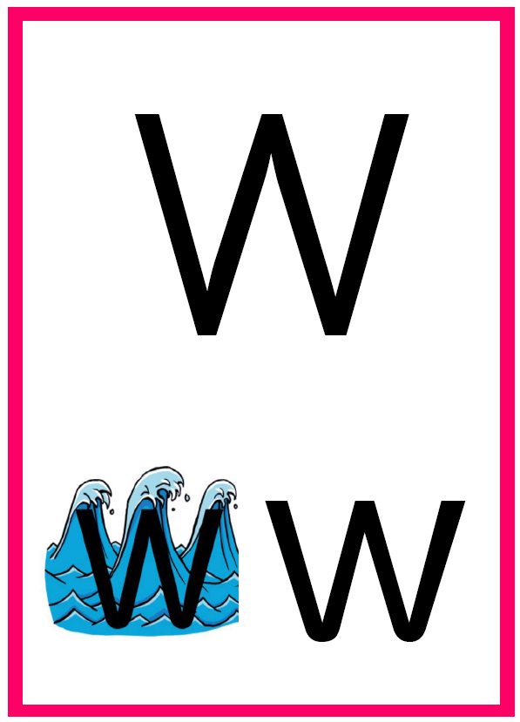
Lowercase Letter Rhyme
From the top of the wave to the bottom, up the wave, down the wave, then up again.
Capital Letter Rhyme
From the top diagonally right to the bottom, diagonally up to the top, diagonally down to the line, then diagonally up again.

Slide 25
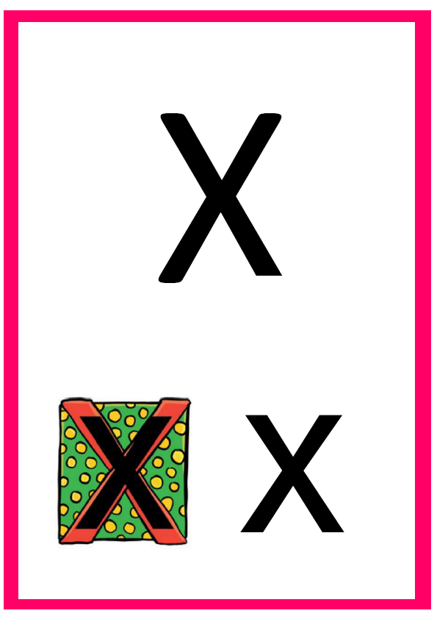
Lowercase Letter Rhyme
Start at the top, then across to the bottom of the box.
Capital Letter Rhyme
From the top, diagonally right to the bottom. Space. Start at the top, then diagonally left to the bottom.

Slide 26

Lowercase Letter Rhyme
Down and round the yo-yo, then follow the string round.
Capital Letter Rhyme
From the top diagonally right to the middle. Space. From the top diagonally left to the middle. Straight down to the bottom.

Slide 27
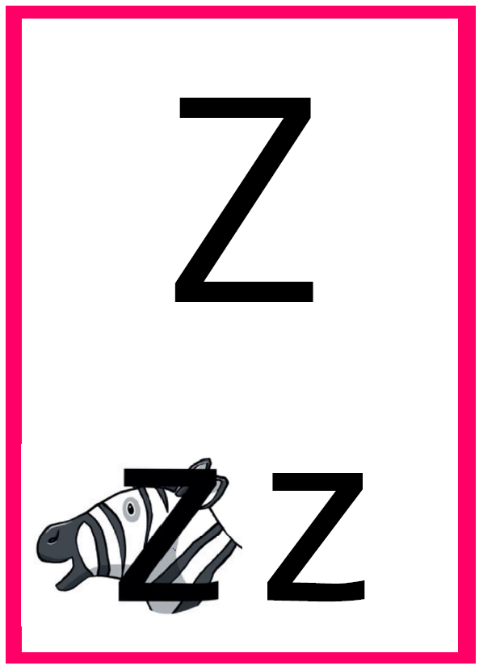
Lowercase Letter Rhyme
Zip across, zag down and across the zebra.
Capital Letter Rhyme
From the top go across, diagonally down to the left and across the bottom.

